Slide 1
Digital Portfolio
STuDENT NAME: Elavarasan p
REGISTERNO AND NMID: asunm117222401454
Department: bsc computer science
College/university: Prof dhanapalan college of science and management/madras university.

Slide 2
PROJECT TITLE
Interactive Digital Portfolio with Resume Integration

Slide 3
AGENDA
1.Problem Statement
2.Project Overview
3.End Users
4.Tools and Technologies
5.Portfolio design and Layout
6.Features and Functionality
7.Results and Screenshots
8.Conclusion
9.Github Link

Slide 4
PROBLEM STATEMENT
In today’s digital era, resumes and traditional paper-based portfolios are no longer enough to showcase skills, achievements, and projects effectively. A digital portfolio allows professionals, especially in tech and creative fields, to present their work in a dynamic, accessible, and professional way. The problem was to create a visually appealing, user-friendly, and responsive portfolio that represents personal branding and provides easy access to information like education, skills, projects, and contact details

Slide 5
PROJECT OVERVIEW
The Digital Portfolio is a responsive, modern web-based application designed to highlight a person’s professional journey. It includes essential sections such as About Me, Education, Certificates, Projects, Skills, and Contact. A dark mode toggle is provided for better accessibility and user experience. The portfolio also features a dedicated resume download button, ensuring quick access for recruiters and employers.

Slide 6
WHO ARE THE END USERS?
The primary end users are students, job seekers, freelancers, and professionals who want to showcase their academic achievements, skills, and project work in an interactive way. Employers and recruiters also form a secondary user base, as they can easily navigate through the portfolio and evaluate a candidate’s profile

Slide 7
TOOLS AND TECHNIQUES
The tools used in this project include:
HTML – for structuring the web pages.
CSS – for styling, gradients, responsive layout, and card-based design.
JavaScript – for interactivity (dark mode toggle, button actions).
VS Code – as the development environment.
Google Fonts – for modern, professional typography.
GitHub – for version control and hosting.
Web Browser DevTools – for debugging and testing responsiveness

Slide 8
The techniques applied are:
Responsive Web Design (RWD): Ensuring the portfolio works smoothly across desktops, tablets, and mobiles.
Flexbox Layout: For aligning the profile photo and text in the header, and maintaining consistent spacing.
Card-Based UI: For clear separation of education, certificates, projects, and skills.
Dark Mode Implementation: Using CSS class toggling with JavaScript for a smooth user experience.
Gradient Themes & Shadows: To enhance the modern and attractive visual appeal.
Hover and Transition Effects: For interactive buttons and links that improve user engagement.
Minimalist Design Principle: Keeping the layout simple, professional, and easy to navigate.

Slide 9
POTFOLIO DESIGN AND LAYOUT
The portfolio follows a modern, clean, and user-friendly design that emphasizes both aesthetics and usability. The layout begins with a header section, which features a profile photo aligned on the left and the name with a professional tagline centered for balance. A dark mode toggle switch is positioned in the top-right corner of the header, giving users control over visual preferences.
Below the header, a navigation bar provides quick access to each section—About Me, Education, Certificates, Projects, Skills, and Contact. Each of these sections is organized using a card-based layout, which creates clear separation, readability, and a professional appearance.

Slide 10
The design uses gradient backgrounds, soft shadows, and rounded corners to maintain a modern and attractive visual identity. White space is carefully applied between sections to avoid clutter, ensuring that the information flows smoothly. The resume download button is strategically placed in the Contact section, making it easy for recruiters or employers to access quickly.
The layout is fully responsive, adapting seamlessly to desktop, tablet, and mobile screens. Techniques like Flexbox and grid alignment ensure that elements remain properly structured, regardless of device size. Overall, the design achieves a balance between visual appeal, simplicity, and functionality, making the portfolio professional yet approachable.

Slide 11
FEATURES AND Functionality
The Digital Portfolio is designed with a focus on usability, interactivity, and professional presentation. Its main features and functionalities include:
Profile Header with Branding: Displays a profile photo, name, and professional tagline, creating a strong first impression.
Dark Mode Toggle: A switch located at the top-right corner allows users to switch between light and dark themes, enhancing accessibility and user comfort.

Slide 12
Responsive Design: Built with HTML, CSS, and Flexbox techniques to ensure the portfolio adapts seamlessly across desktop, tablet, and mobile devices.
Navigation Bar: A fixed menu bar provides smooth and quick navigation to different sections like About, Education, Certificates, Projects, and Contact.
Card-Based Sections: Information such as education, certificates, and projects is presented in clean card layouts for readability and a professional appearance.

Slide 13
Resume Download Button: A dedicated button in the Contact section enables recruiters to download the resume instantly in PDF or Word format.
Interactive Elements: Hover effects, smooth transitions, and button highlights make the portfolio engaging and modern.
Project Showcasing: Dedicated project section highlights problem statements, overviews, tools used, and results, making it easy to demonstrate practical skills

Slide 14
Minimalist Design Principle: Clear typography, proper spacing, and pastel-to-dark theme gradients keep the portfolio visually appealing yet distraction-free.
Accessibility Support: Sufficient contrast in dark mode and mobile-friendly layout ensure easy navigation for all users.

Slide 15
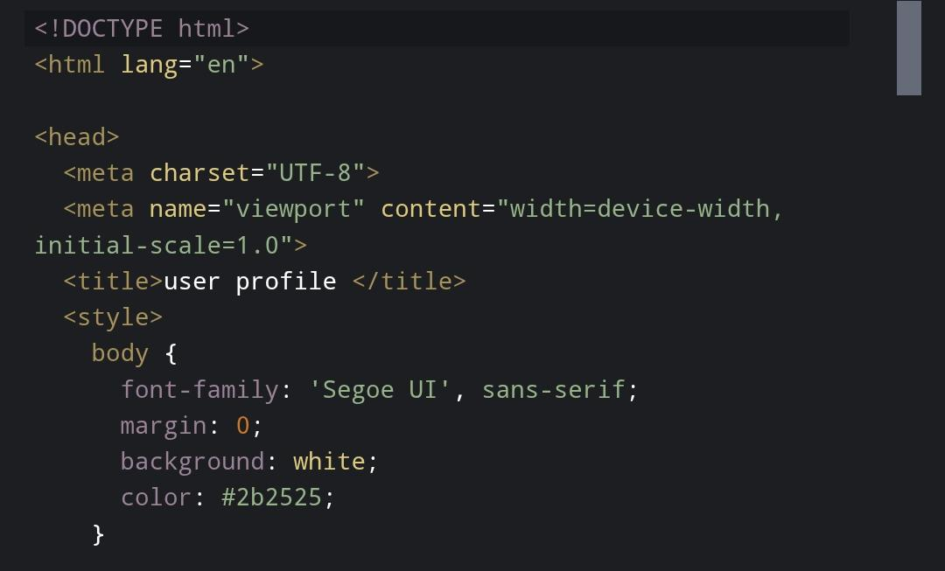
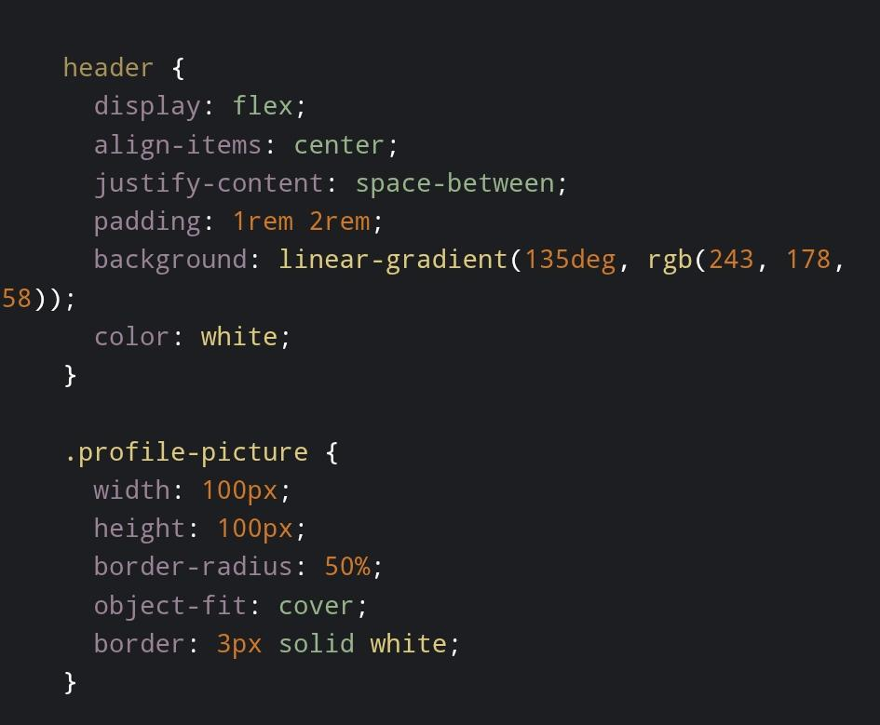
RESULTS AND SCREENSHOTS

Slide 16
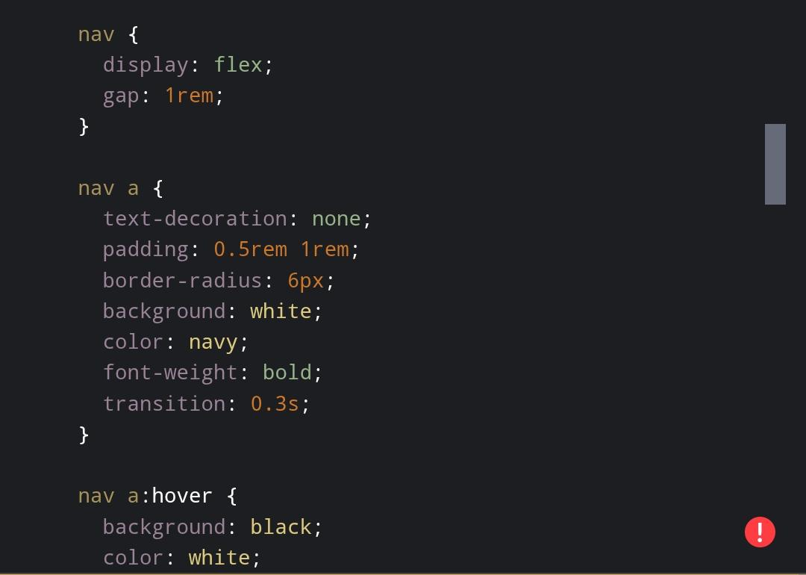
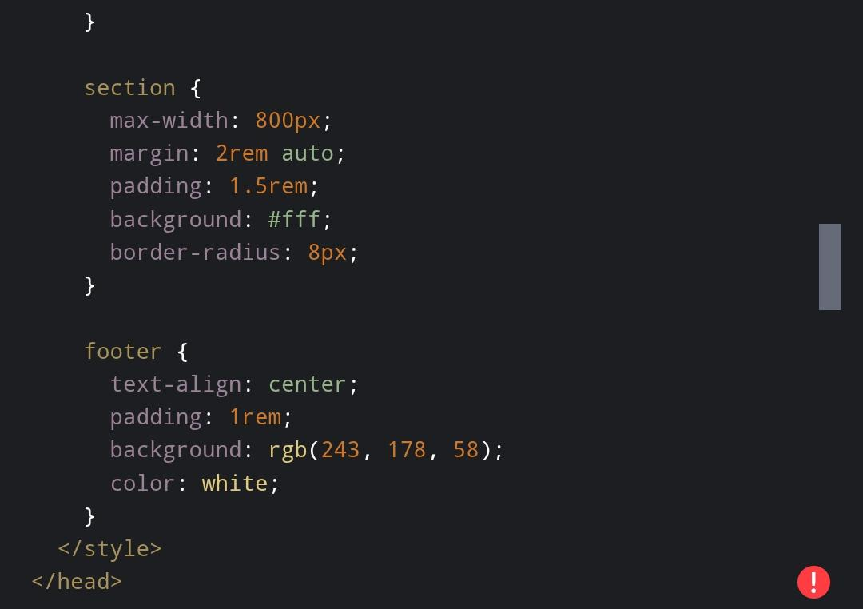

Slide 17
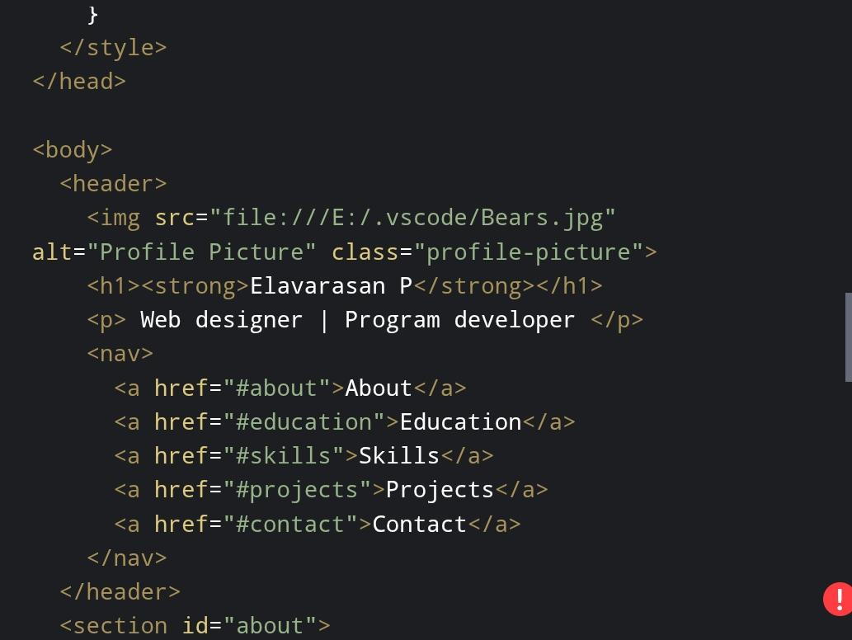
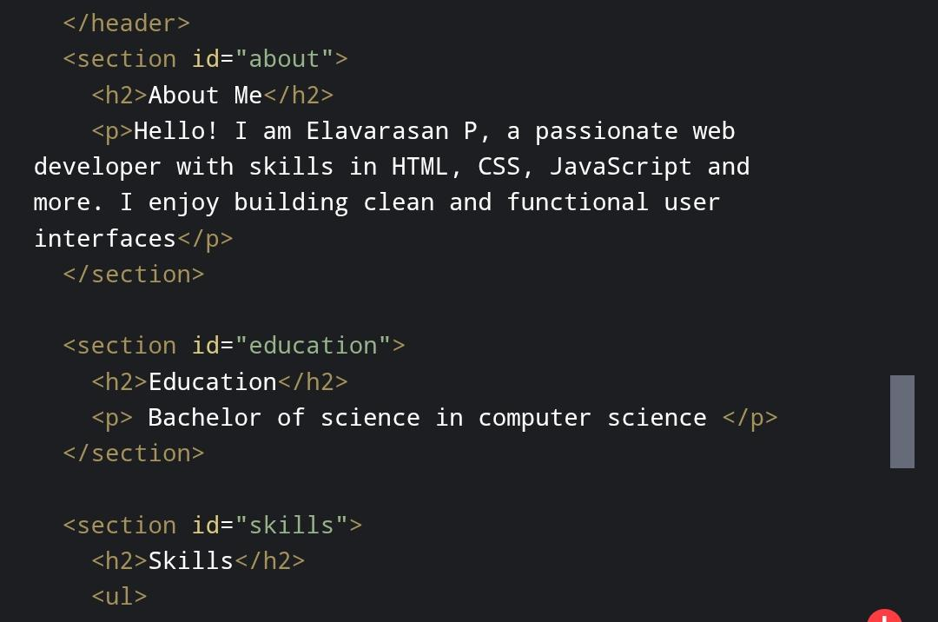

Slide 18
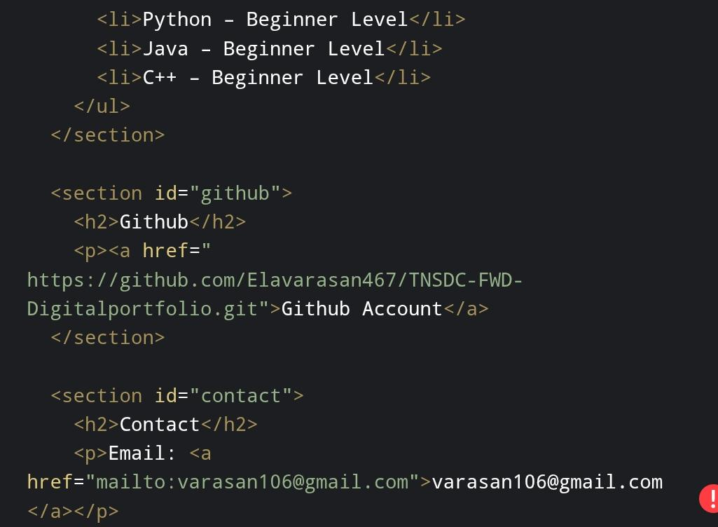
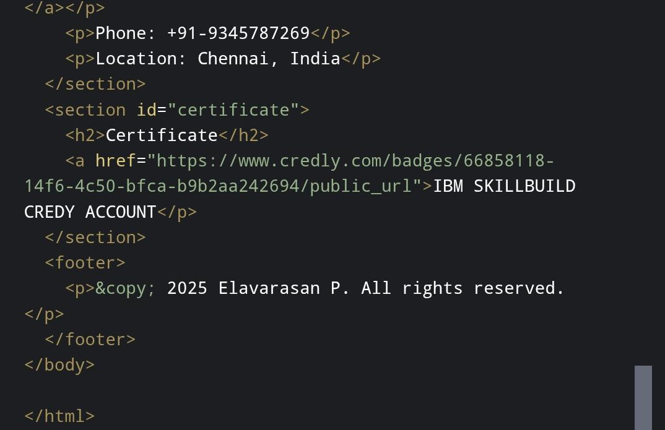

Slide 19


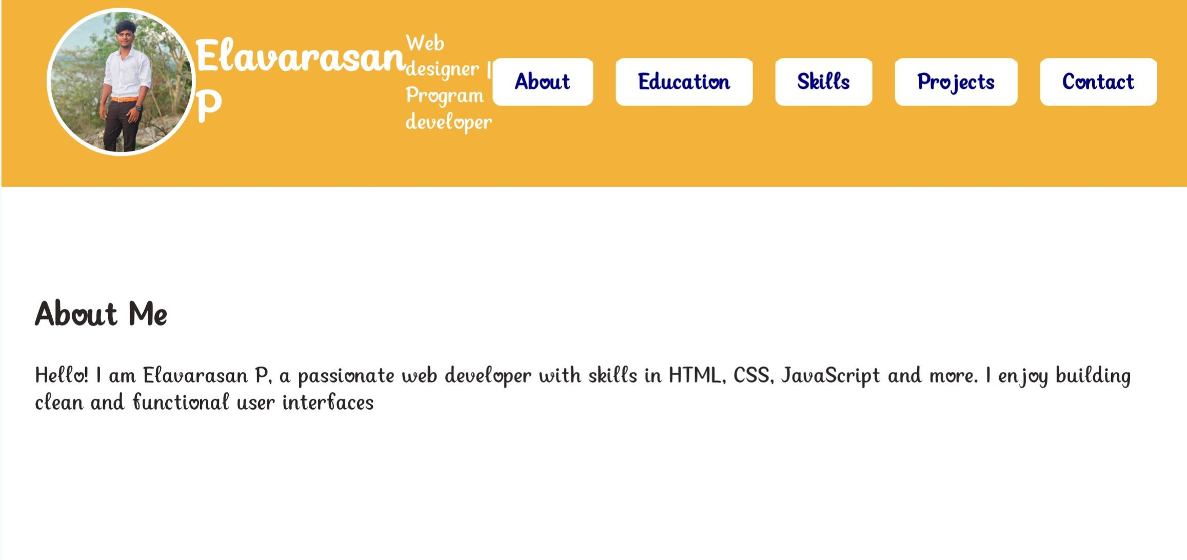

Slide 20
CONCLUSION
This project successfully delivers a simple yet powerful digital portfolio that can replace traditional resumes and enhance personal branding. It not only demonstrates technical skills in front-end development but also highlights creativity in UI/UX design. With the addition of more interactivity and backend integration in the future, the portfolio can be further expanded into a personal website or professional blog, making it a strong career asset.

